Slide 1
Developing FrameNet Parser
Ryan Schaefer, Rick Lattin

Slide 2
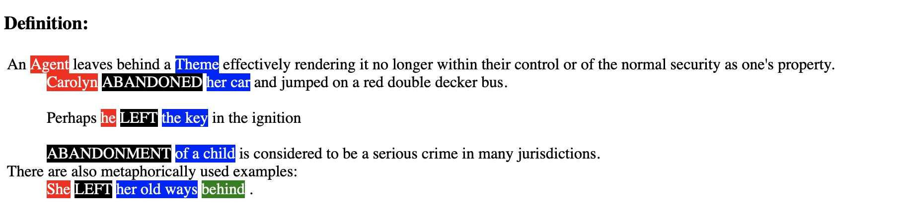
What is FrameNet?
Frame
Lexical Unit
Frame Element

Slide 3
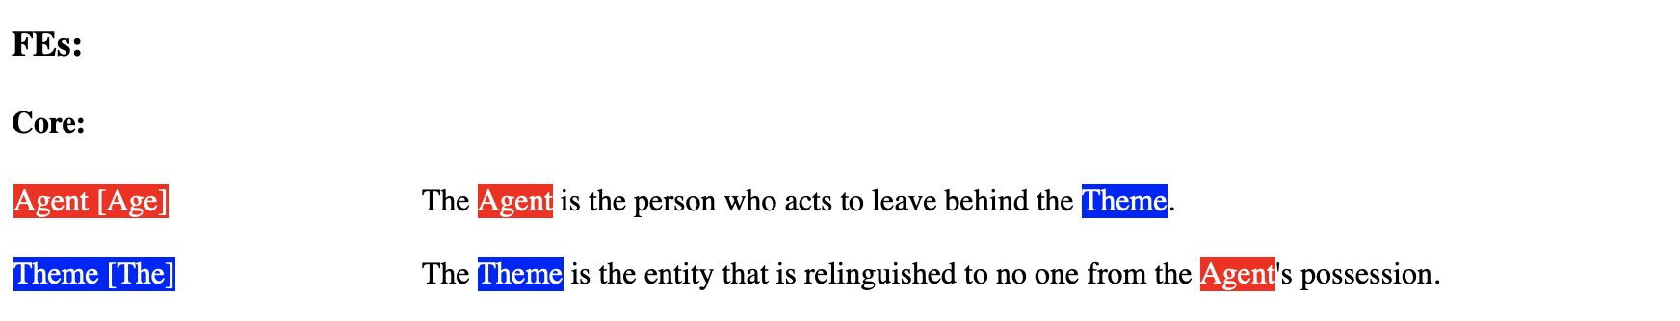
What is FrameNet?
Frame
Lexical Unit
Frame Element

Slide 4

Intro to Project
Two tasks:
Determine relevant frames for a given sentence
Determine frame elements related to a specific frame
Using FrameNet lexical database

Slide 5

Our Project
Focusing on task 1 of the 2
Establishing frames for given lexical units throughout sentence
No longer attempting to classify frame elements

Slide 6
Setting up FrameNet
Determined lexical units with more than one frame
If there was at least 10 example sentences for the lexical unit’s most common frame, a decision tree was trained
Otherwise implemented probability rules to predict frames based off lexical units

Slide 7
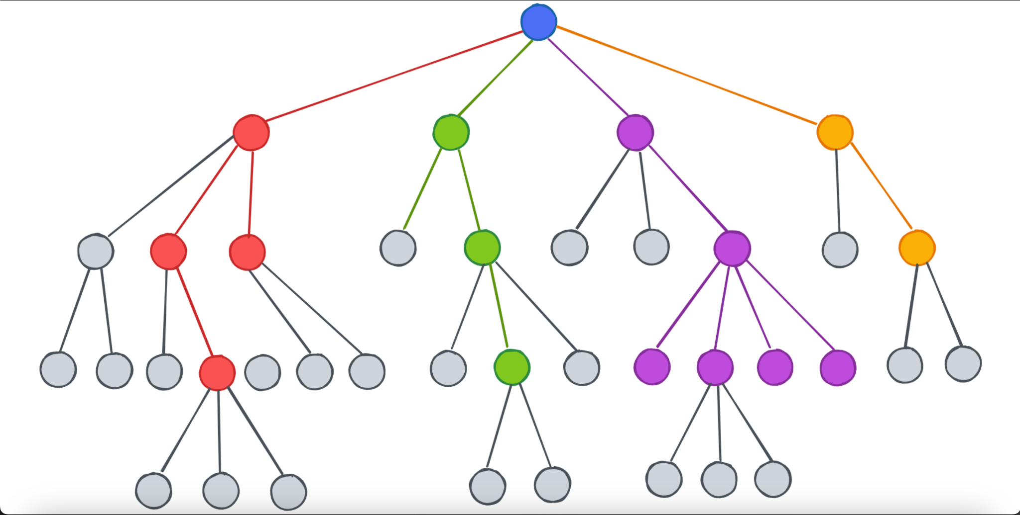
Model Architecture
One decision tree classifier per lexical unit with enough training sentences
Collected features from dependency parser and lexical unit index in sentence
Trained off of sentences to identify the frame for a given lexical unit
Notes:
Fact check the lexical unit comment

Slide 8
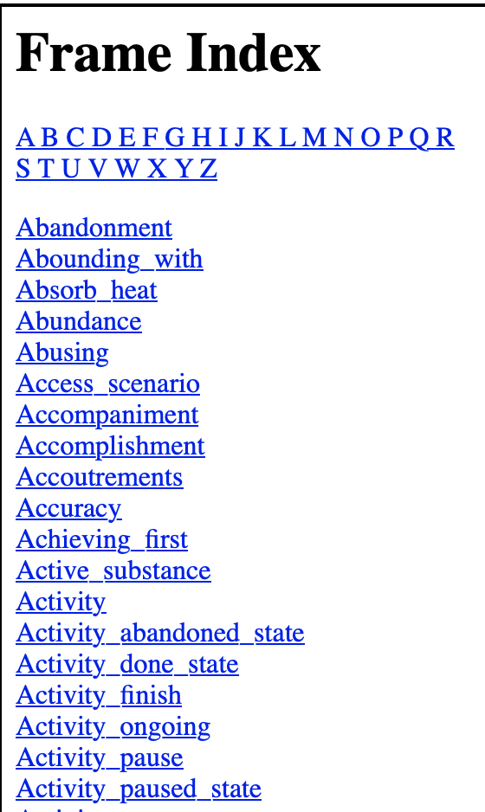
Picking Frames for Targets
Determine each lexical unit in the sentence
Determine every possible frame for the lexical unit
If not only one frame, use decision tree or probability rule
Notes:
If only one possible frame, assign it to the lexical unit, otherwise use the decision tree classifier created for that lexical unit to make the choice on its frame

Slide 9
Initial Results
Model 1 Results
95.3% correct prediction when the lexical unit was already identified
92.3% words in the sentence tagged with frames correctly
Average of 12.3 extra predictions per sentence
Much too high false positive rate
Created second model to account for this

Slide 10
Model 2
Attempted to correct for high false positive rate
Added no-frame labels to decision trees
Removed random frame prediction for lexical units with small sample sizes
Results
95.6% correct prediction when the lexical unit was already identified
84.6% words in the sentence tagged with frames correctly
Average of 5.07 extra predictions per sentence

Slide 11
Final Results
Model 1:
95.3% correct prediction when the lexical unit was already identified
92.3% words in the sentence tagged with frames correctly
Average of 12.3 extra predictions per sentence
Model 2:
95.6% correct prediction when the lexical unit was already identified
84.6% words in the sentence tagged with frames correctly
Average of 5.07 extra predictions per sentence
Notes:
*fact check these

Slide 12
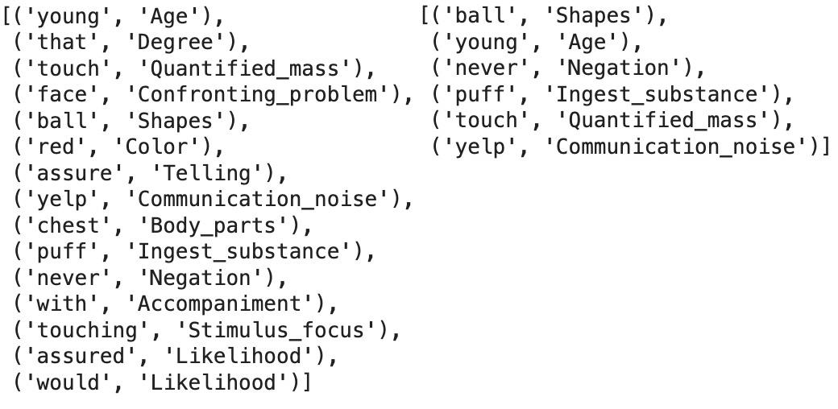
Predictions Example
Predictions for the sentence: “Face red, chest puffed with indignation, young John would yelp: ‘I assure you quite categorically that I never touched the ball.’”
Tagged frame is “Communication_noise” for the lexical unit “yelp”
The left column is model 1 and the right is model 2

Slide 13

Limitations
Limited FrameNet labeled data
Training
Testing
Limited by words entered into FrameNet
Unable to determine uninstantiated frames

Slide 14
Questions?

